Slide 1

MINI PROJECT SCOPE
Future-Proof your Business

Slide 2


Agenda
Introduction - Project Scope
Implementation Methodology
Project-Team Organization
Project Timelines
Roles & Responsibilities
Project Controlling

Slide 3
Project Scope
Legal Entity: Implementation of End-to-End data analysis project with data of Medico Pvt. Ltd. using snowflake as SaaS data warehouse and tableau dashboard to present KPI's along with machine learning and data science to find insight from data.
Functional & Technical Scope: Implementation of ETL & Data Cloud from different data views for different Channels :
KPI Wise: *** KPI’s and other scope are as per attached
In addition to above:
Data loading and Unloading in snowflake.
Different Admin Work in Snowflake.
Tableau Desktop installation,
Connection & Configuration with Tableau Server
Extract Creation & Auto Refresh Scheduling will be implemented
Data science platform and Machine learning platform identification
Machine learning implementation.

Slide 4
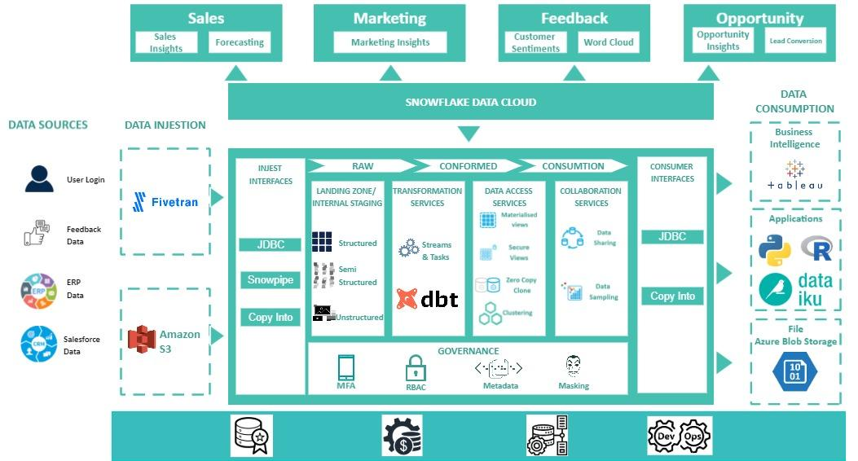
Implementation Methodology
High Level Architecture

Slide 5
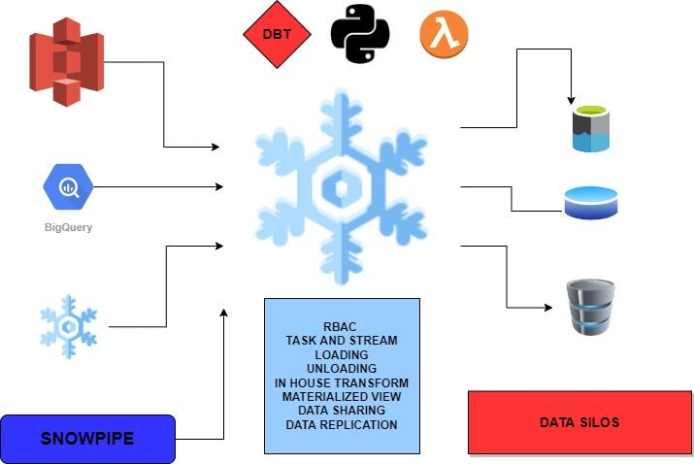
Snowflake Architecture

Slide 6
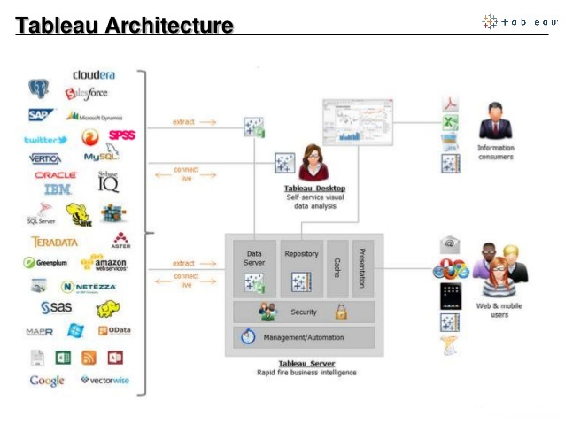
Tableau Architecture

Slide 7
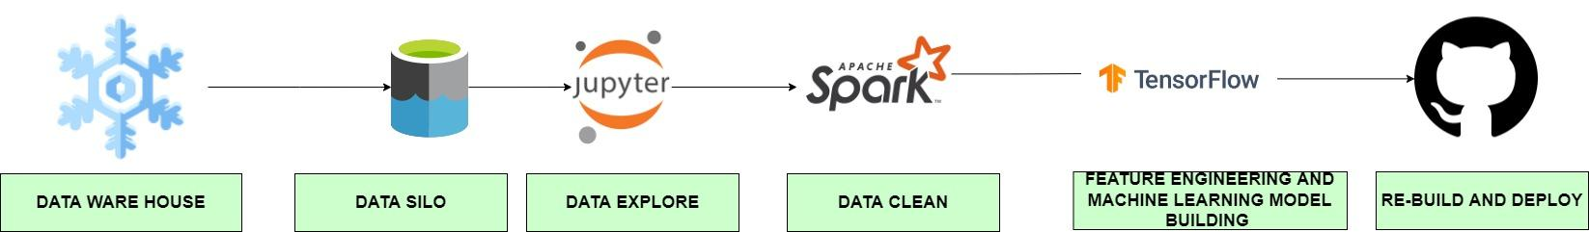
Data Science Architecture

Slide 8
Project Team Organization
Mentor
Tushar Jadhav
Captains
Mahendra Singh
Satyajit Maitra
Consultant
Satish Kumar
Aditi Methi
Yuktha Raman G V
Anant Kashyap
Mohammad Osama Akhtar
Shaksham Agarwal
Pradeep Gandham
Anvesh Pandey

Slide 9
Project Implementation Timelines
Project – Phase | Timelines | Priority | Start Date
Discovery of Ideas and defining the scope of the project. | 5 Days | 1 | 10-01-2022
Building the data infrastructure and the overall Data Services | 5 Days | 2 | 17-01-2022
Building the data warehouse and associate infrastructure | 5 Days | 3 | 24-01-2022
Building the Dashboard for Key KPI visualizations | 5 Days | 4 | As per data Availability
Building the data science flowline for getting insights | 5 Days | 5 | As per data Availability
Building the machine learning models and iterate for improvement | 5 Days | 6 | As per data Availability
Taking Feedback and Re-evaluate the project based on Feedback | 5 Days | 7 | 07-02-2022
Final Presentation |  |  | 14-02-2022

Slide 10
Roles & Responsibilities
Mentor
Overall Project management
Coordination with Management and Key-Consultants
Project scope control
Project reporting to Client.
Business processes requirements consolidation and validation
Business resources availability management
Change management actions handling ,Technical Support & Consulting Guidance

Slide 11
Captain
Functional workshop leads to collect information to build the model
Planning and progress management during weekly project committees
Delivery of the ETL solution & KPI development in line with business requirements
Documentation of system solutions
Effectively schedules, organizes and moderates project meetings.
Monitor and track overall progress and results of the project.
Regularly communicates and coordinates with the Mentor and Consultants.

Slide 12
Key User-SME(Client)
Key users will be available for the following main processes:
Requirement Analysis
Database understanding and ETL mapping for data cloud preparation
Business Rule Implementation in Dashboard
Dashboard designing & Development based on Actual data
Data Science Workflow and Machine Learning Understanding
During project lifetime, involved for each business area of responsibilities with:
Business processes design,
Solutions validation for setting up in BI Platform,
Global approval tests scenarios writing and running if any.
End users training management along with BI Consultant
Change management:
Responsible to identify the impacts on business processes, organizations and user skills
Define and implement the actions to help the company to get prepared to those impacts

Slide 13
Project Controlling
Issue Management
Definition – an issue is anything that will impede project progress.
Recording – use pre-delivered issue log to log and monitor project issues
Change Management
Definition – any change in requirement after Requirement sign-off
– any activity which is out of the agreed upon scope.
Change Request submitted by Customer Project leads.
Time, Effort and Cost estimation of implementing Change by Captains Team
Approval by Customer
Execution by Captains
Documentation Standards
Storage – all project documentation should reside on a shared network drive
Use pre-delivered templates when available
Use customer specific working documents when template is not available
Meetings & Reviews
A Weekly status report which will highlight the status of the project & related activities
Weekly review meetings by Client

Slide 14
THANK YOU
‹#›

